Slide 1

CS331 Project 3
Wenkai Tan
Amarjhit Singh
Tenzin Wangyal
Shane O’Neill
Tao Hu
Jagmandeep Dhaliwal

Slide 2

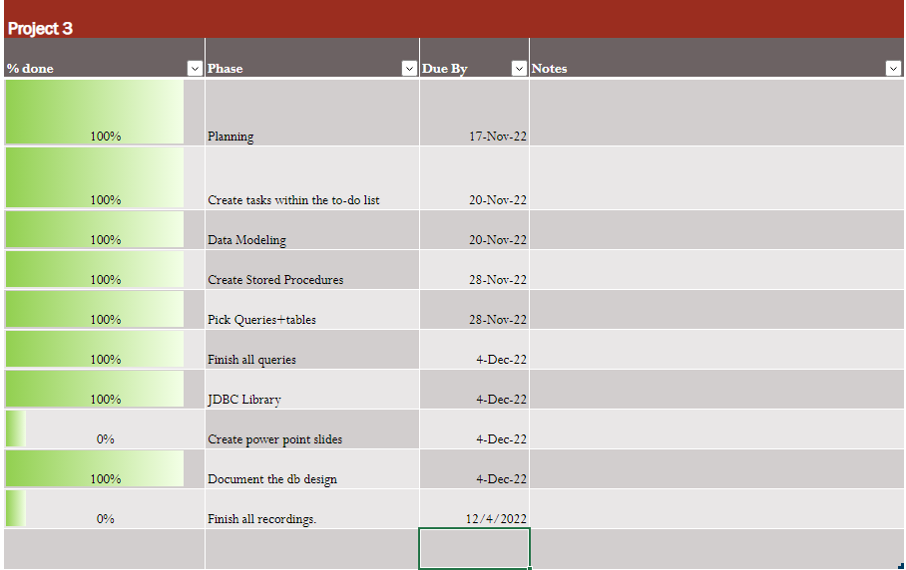
To Do List: Wenkai Tan

Slide 3

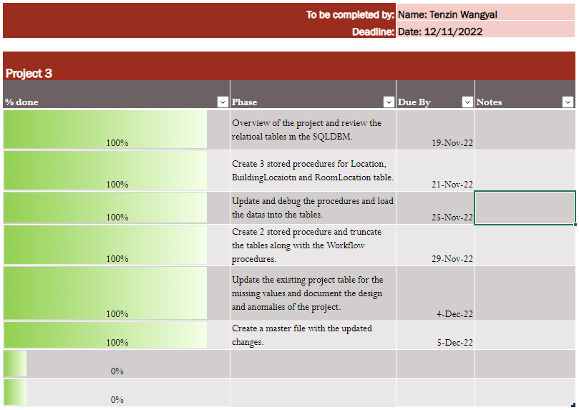
To Do Lost Tenzin Wangyal

Slide 4
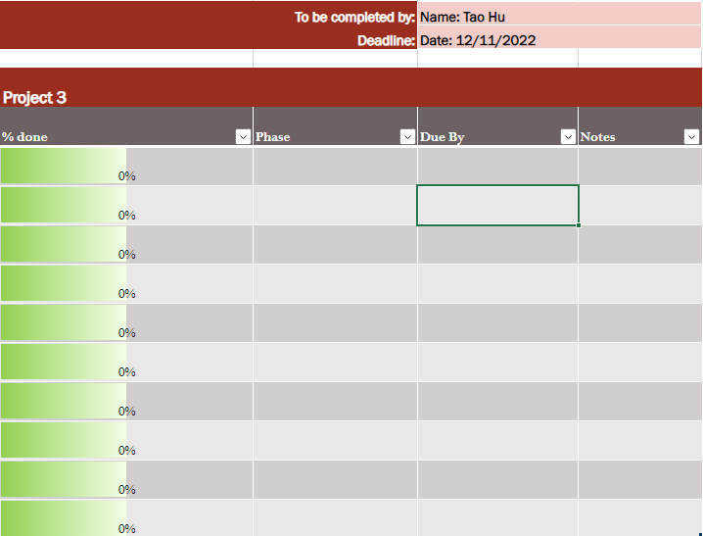
To Do List Tao Hu

Slide 5

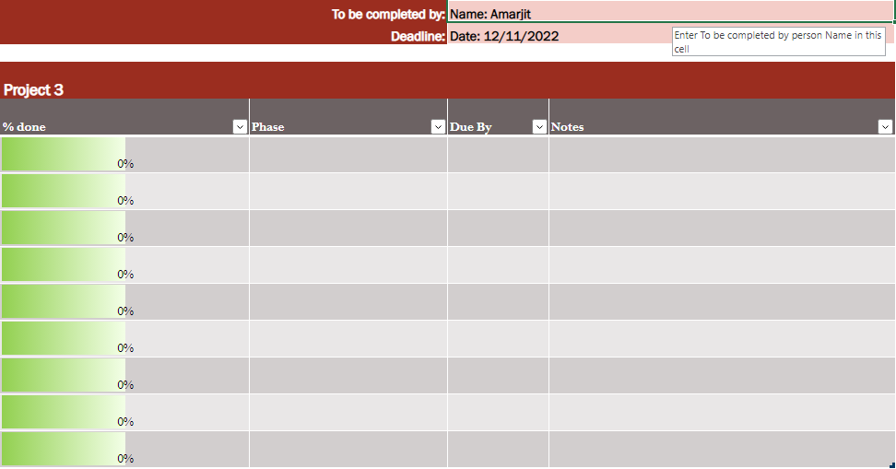
To Do List Amarjit Singh

Slide 6

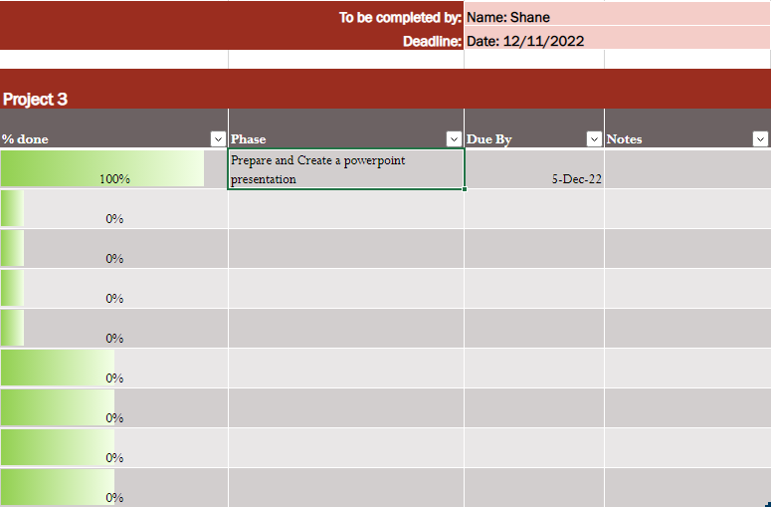
To Do List Shane O’Neill

Slide 7

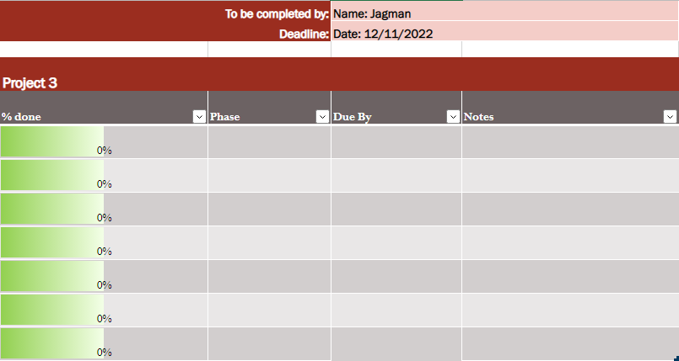
To Do List Jagmandeep Dhaliwal

Slide 8

Project planner

Slide 9
Meeting notes

Slide 10
Planning
-Roles were assigned to each group member
-workflow was kept track of, roles were assigned based on the capabilities of each member

Slide 11
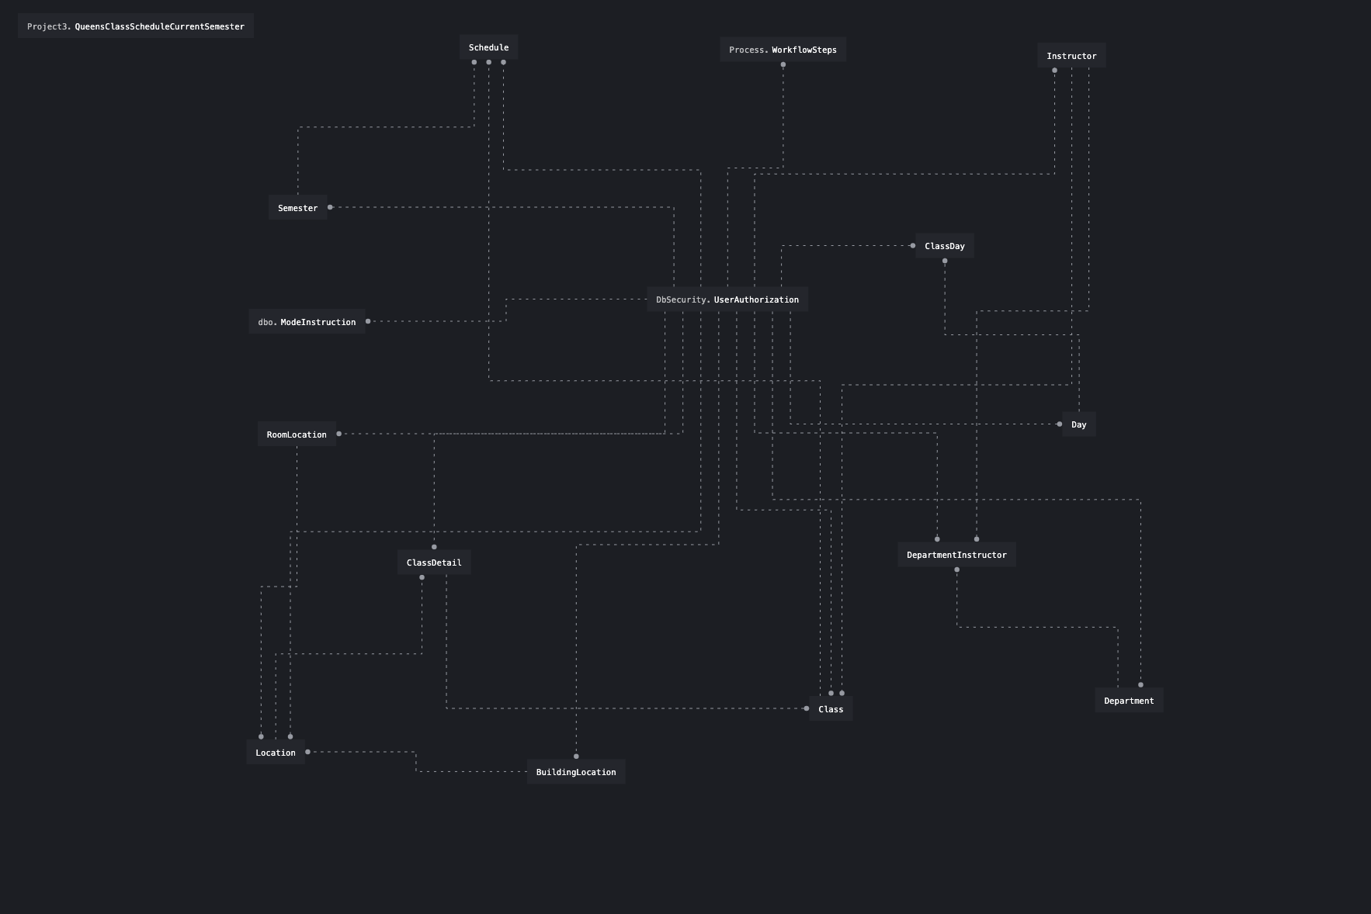
Conceptual Data Model

Slide 12
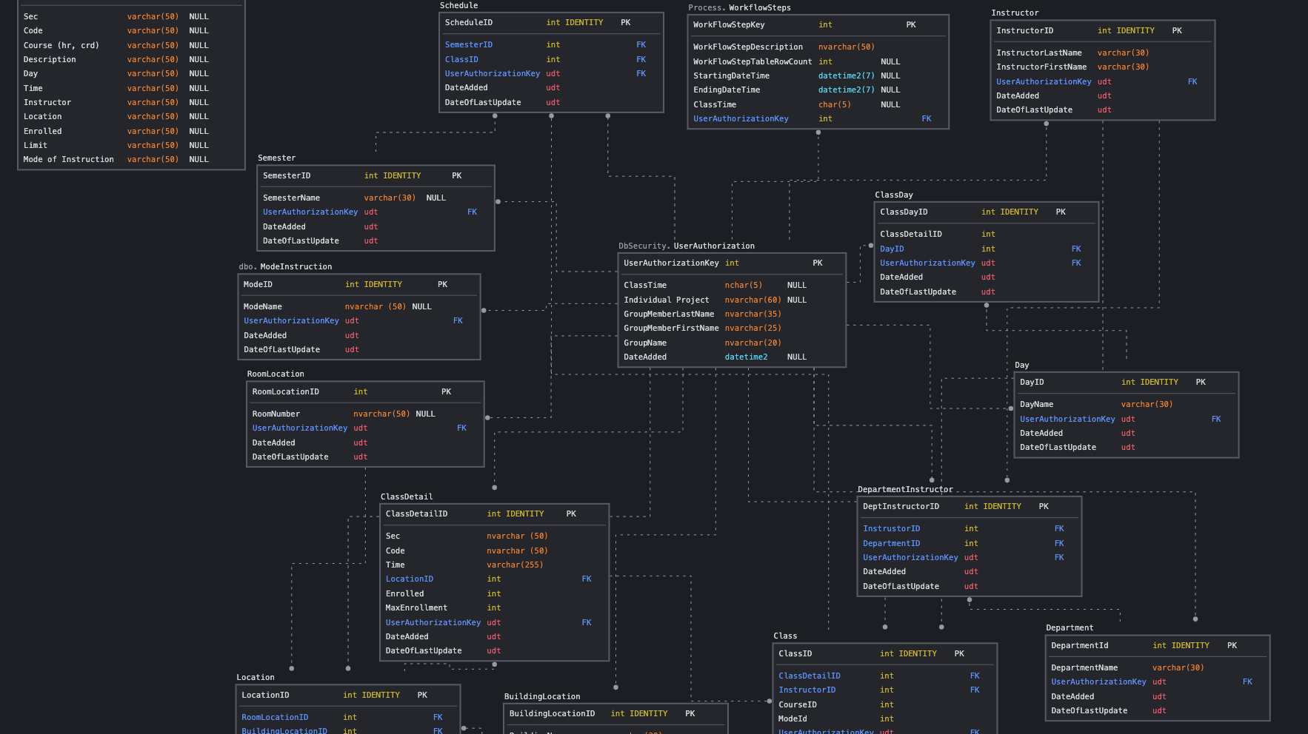
ERD Diagram

Slide 13
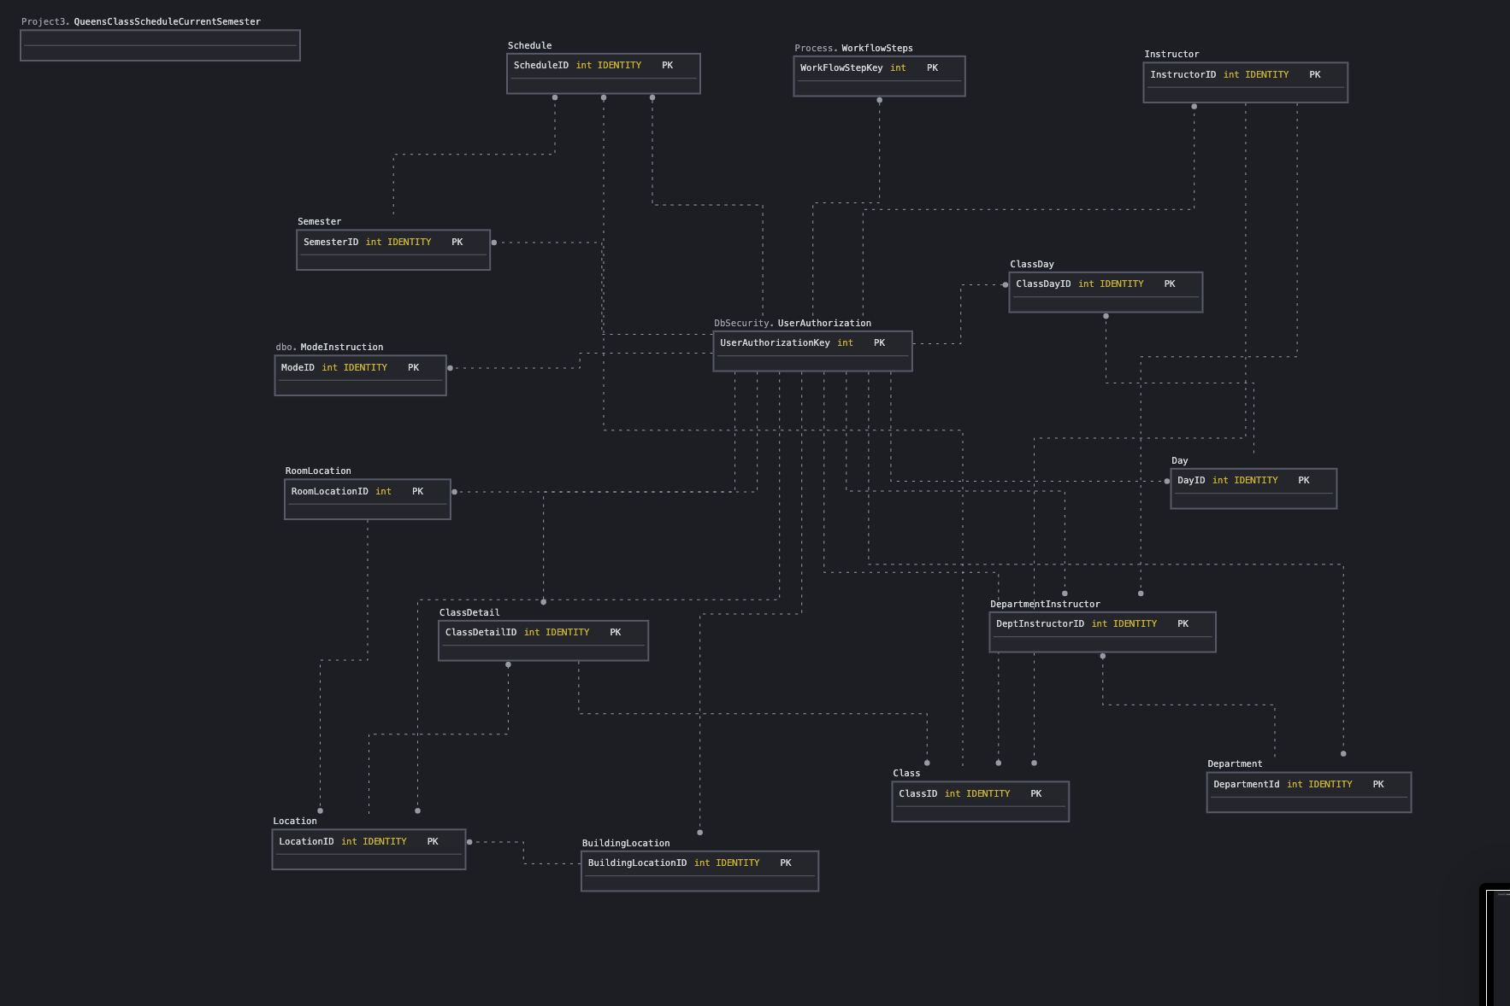
Logical Data Model

Slide 14
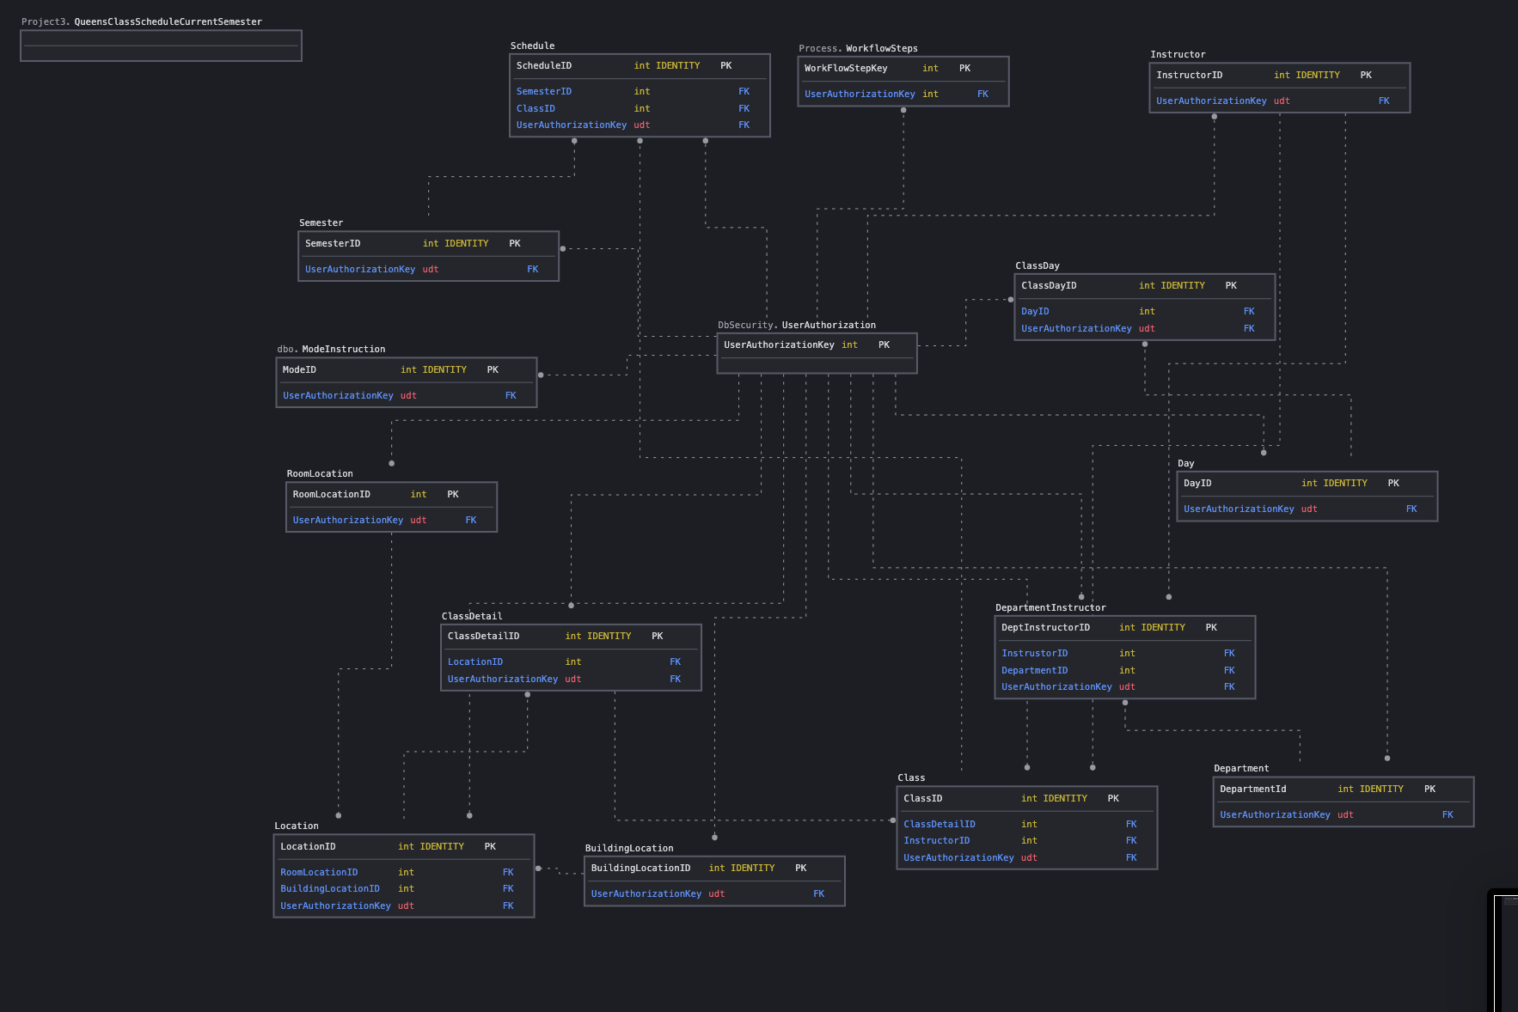
Physical Data Model

Slide 15
Wenkai Tan’s Tables and Procedures
-LoadClassDetail - Procedure
-LoadCourse - Procedure
-LoadDay - Procedure
-ShowWorkFlowSteps - Procedure
-usp_TrackWorkFlow - Procedure
-usp_ShowWorkFlow - Procedure
-LoadClassDay - Procedure
-classDay- Table
-ClassDetail- Table
-Day- Table

Slide 16
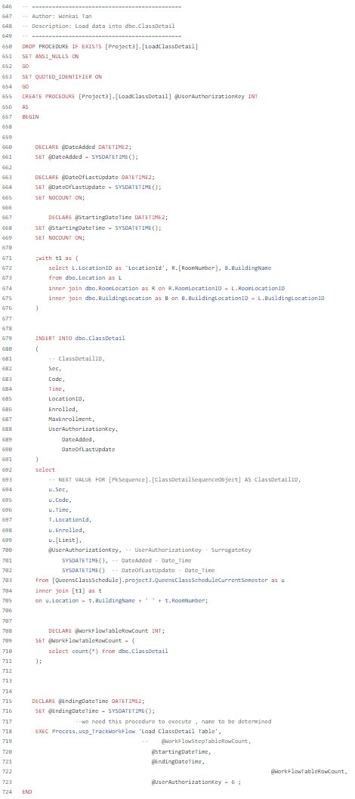

Load Class Detail Procedure Code

Slide 17
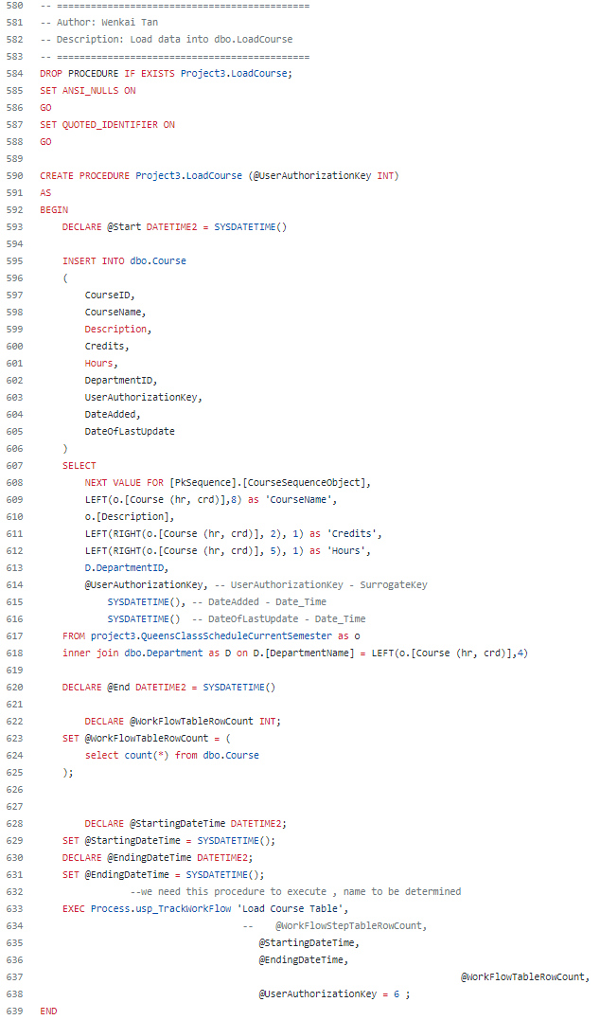

Load Course Procedure Code

Slide 18

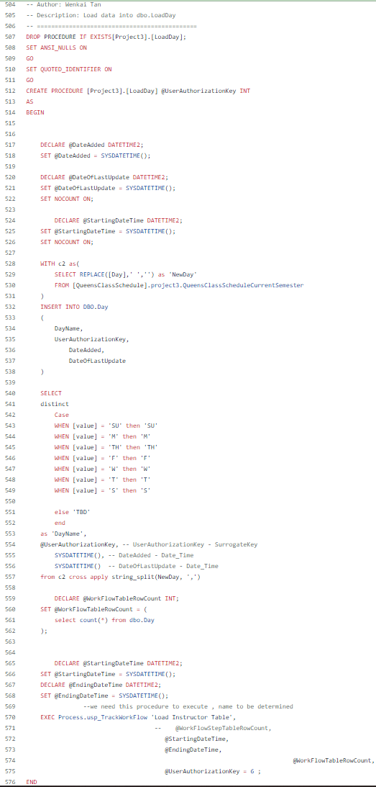
Load Day Procedure Code

Slide 19

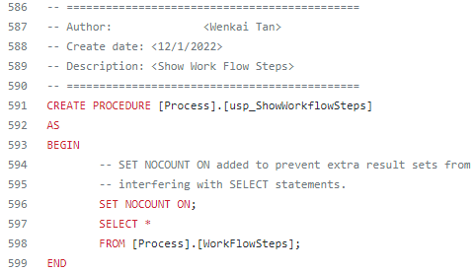
ShowWorkFlowSteps Procedure Code

Slide 20

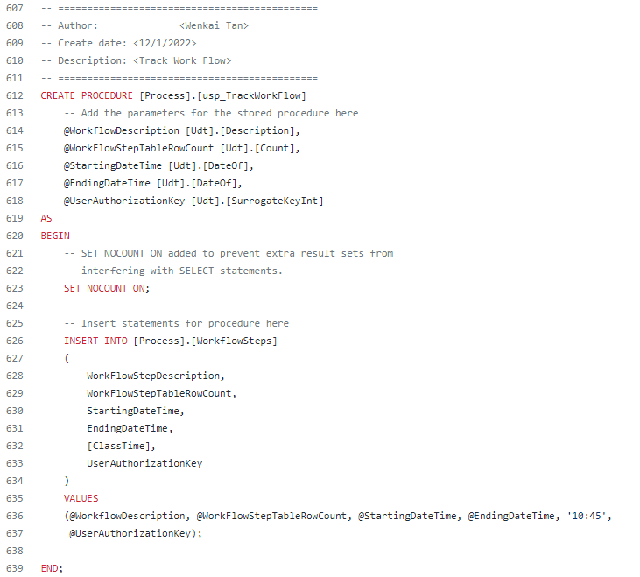
TrackWorkFlow Procedure Code

Slide 21

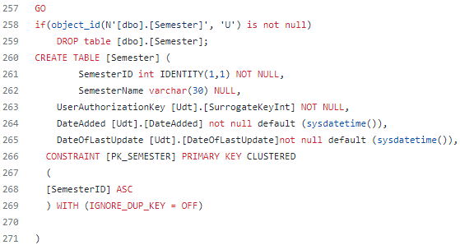
Semester Table Code

Slide 22

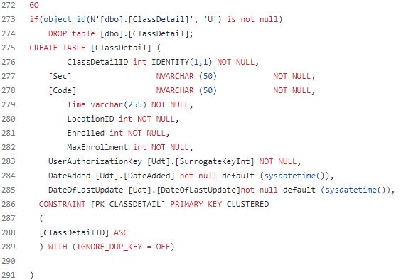
ClassDetail Table Code

Slide 23
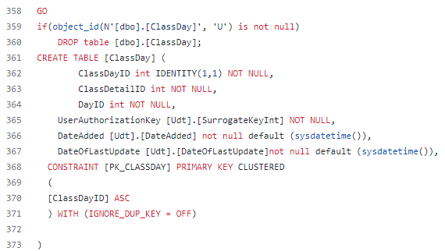
ClassDay Table Code

Slide 24

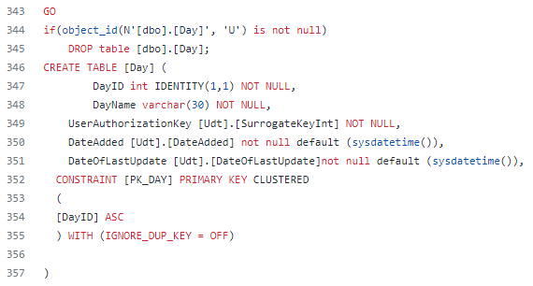
Day Table Code

Slide 25
Tao Hu’s tables and stored procedures
-LoadDepartmentInstructor - Procedure
-LoadLocatrion - Procedure
-LoadModeInstruction - Procedure
-LoadRoomLocation - Procedure
-LoadBuildingLocation - Procedure
-LoadInstructor - Procedure
-LoadDepartment - Procedure
-Department - Table
-Instructor - Table
-DepartmentInstructor- Table

Slide 26
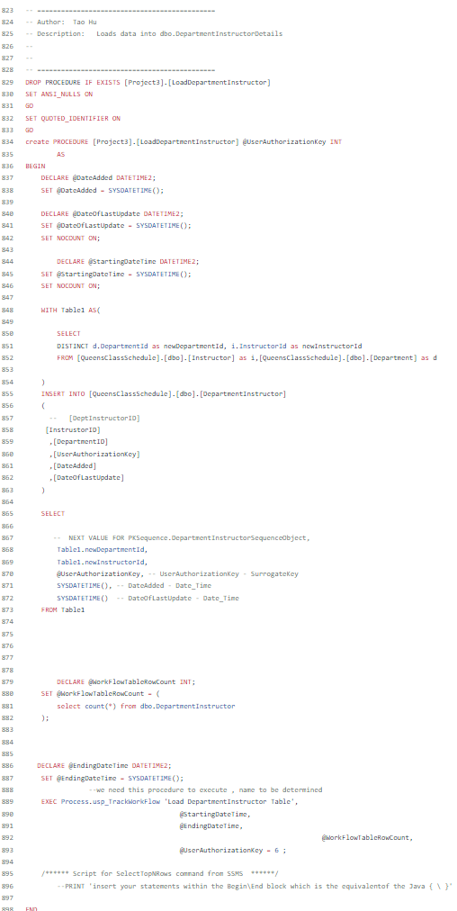
Load Department Instructor Procedure Code

Slide 27

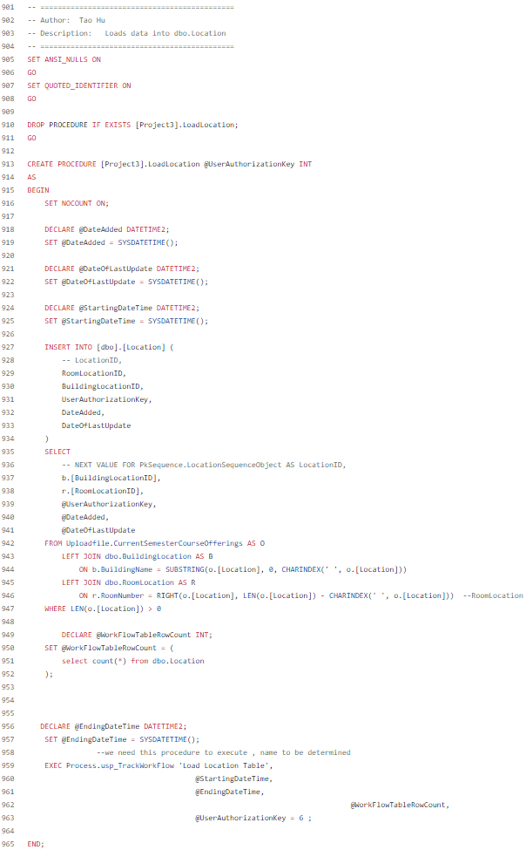
Load Location Department Code

Slide 28

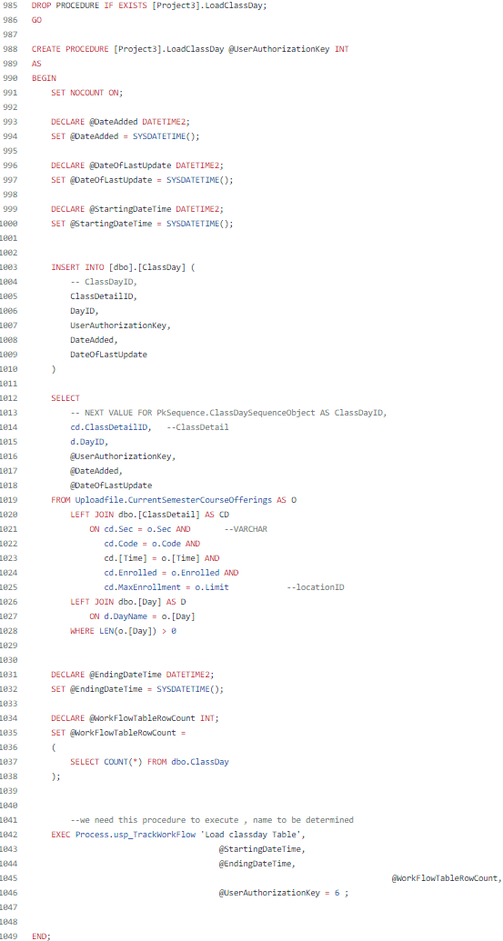
Load Class Day Procedure Code

Slide 29
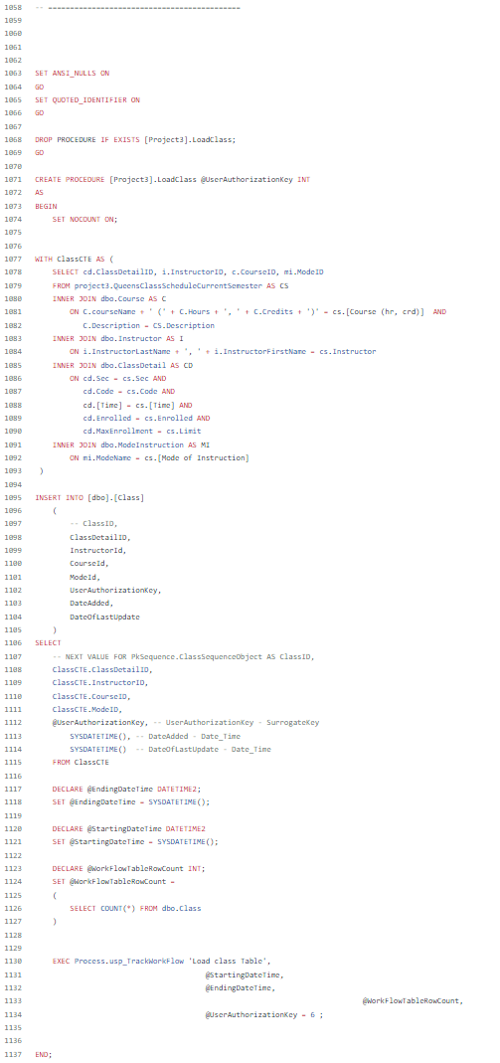
Load Class Procedure Code

Slide 30
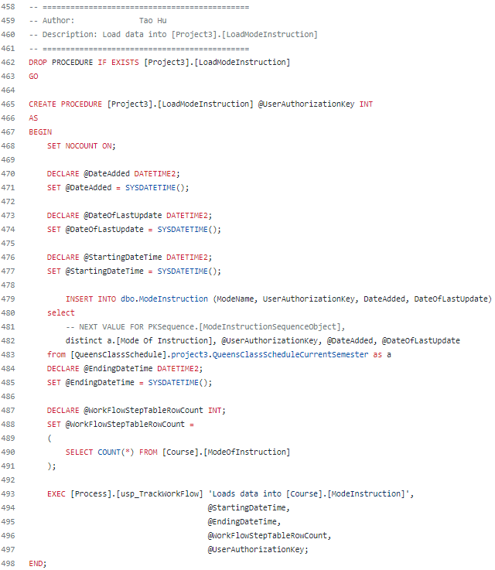
Load Mode Instruction Procedure Code

Slide 31
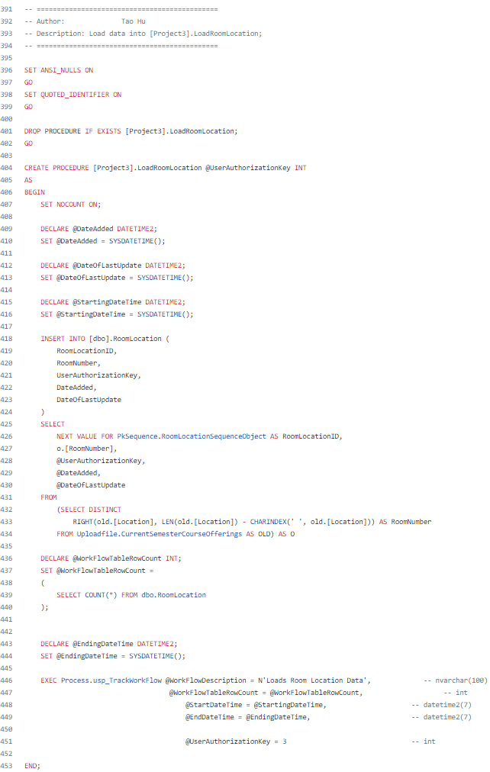
Load Room Location Procedure Code

Slide 32

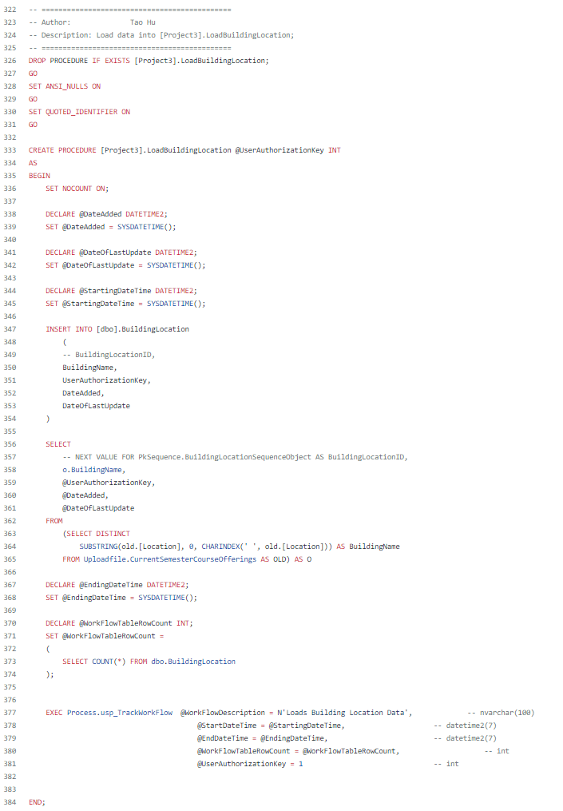
LoadBuildingLocation Procedure Code

Slide 33
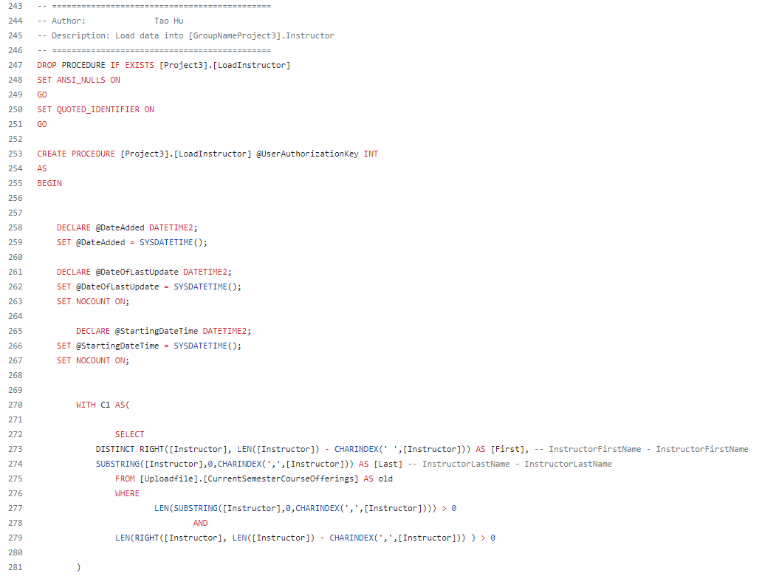
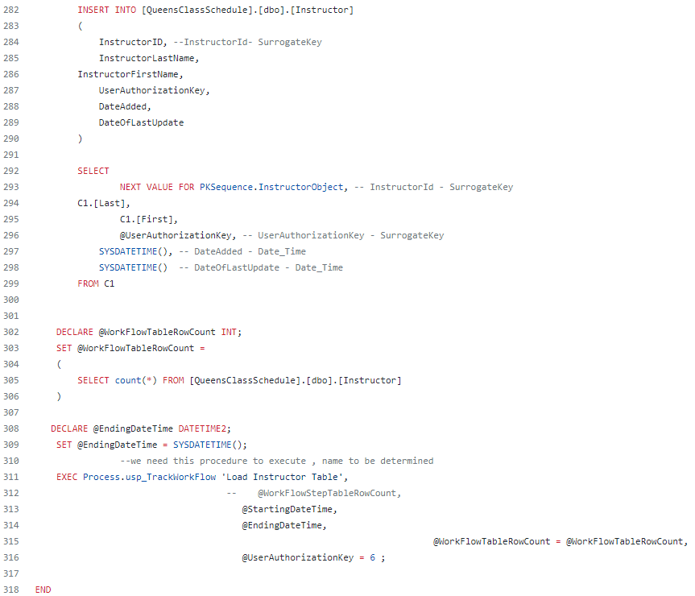
LoadInstructor Procedure Code

Slide 34

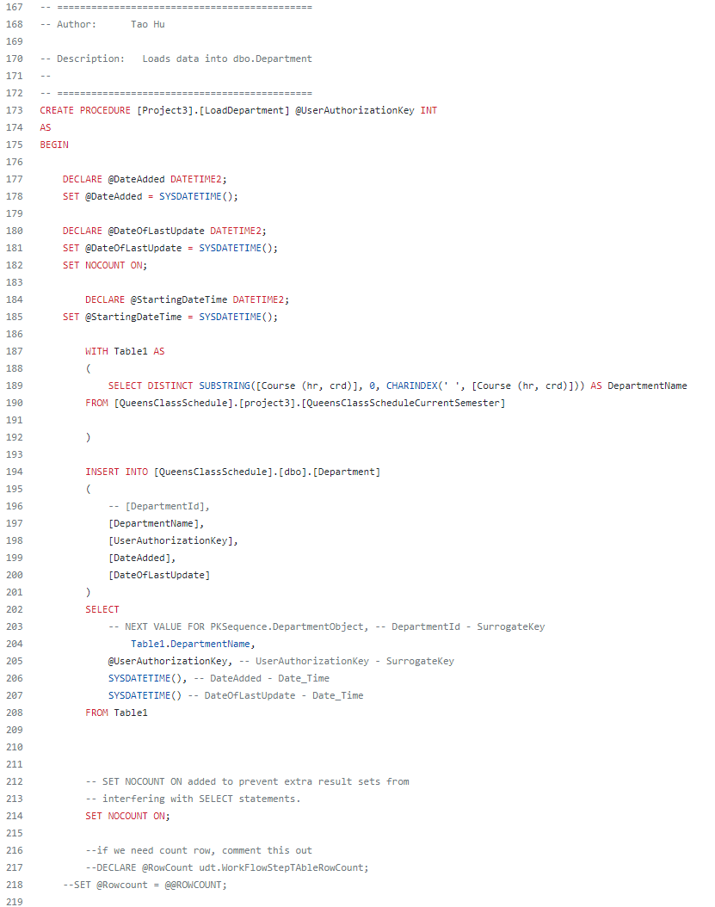
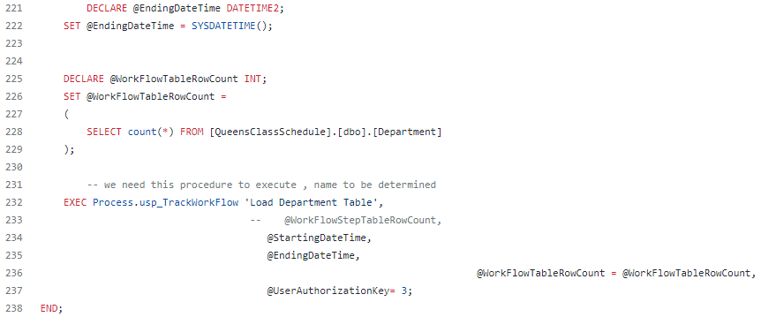
Load Department Procedure Code

Slide 35

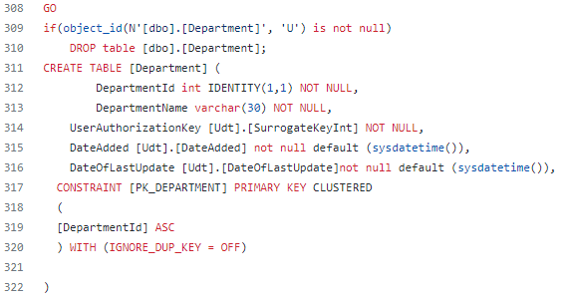
Department Table Code

Slide 36
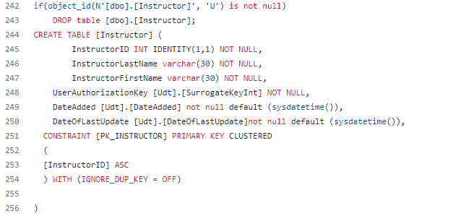
Instructor Table Code

Slide 37
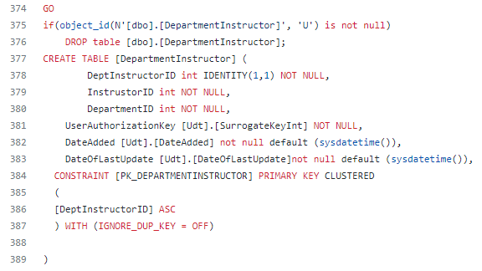
DepartmentInstructor Table Code

Slide 38

Jagmandeep Dhaliwal’s tables and Procedures
-Class - Table
-Course - Table
-Schedule - Table
-LoadClass - Procedure

Slide 39

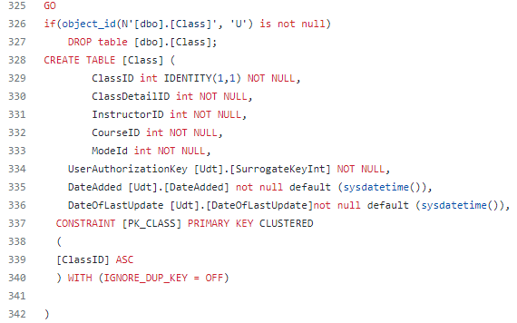
Class Table Code

Slide 40

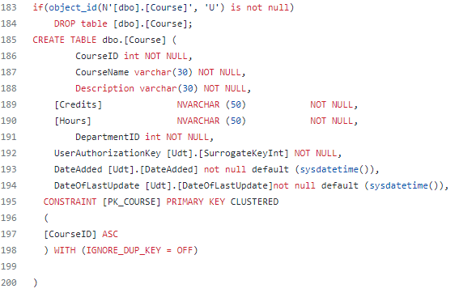
Course Code

Slide 41

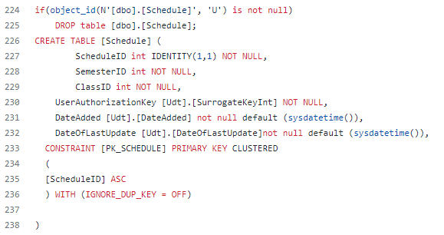
Schedule Table Code

Slide 42
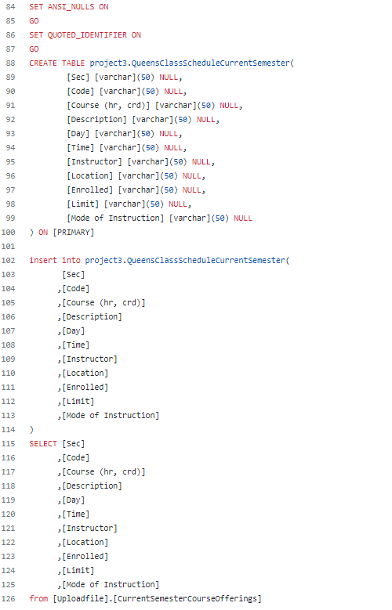
Class Scheduele code

Slide 43

Tenzin Wangyal’s Tables and Procedures
-Location - Table
-BuildingLocation - Table
-RoomLocation - Table

Slide 44
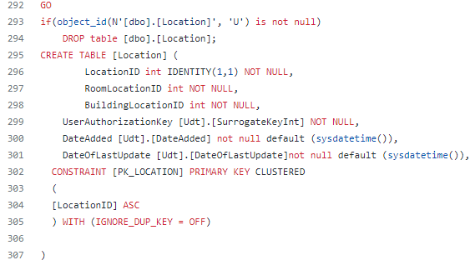
Location Table Code

Slide 45
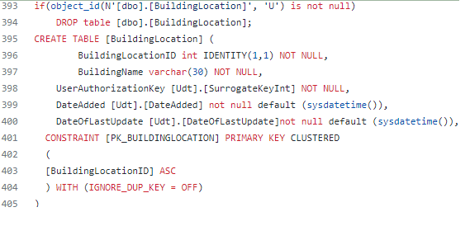
BuildingLocation Table Code

Slide 46
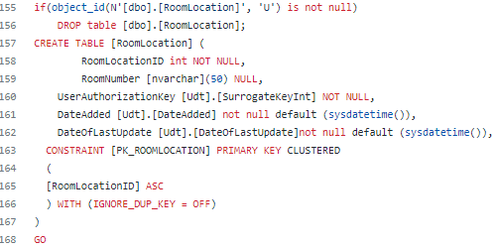
Room Location

Slide 47

Amarjit Singh’s Tables and Procedures
-UserAuthorization - Table
-WorkflowSteps - Table
-ModeInstruction - Table

Slide 48
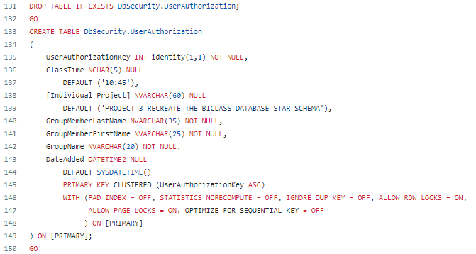
User Authorization

Slide 49
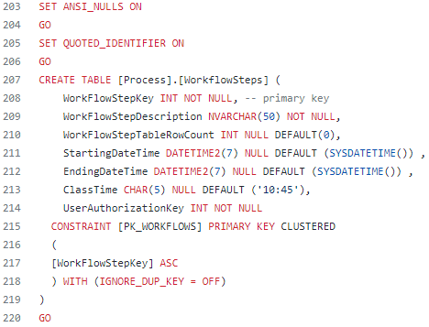
WorkflowSteps Table Code

Slide 50
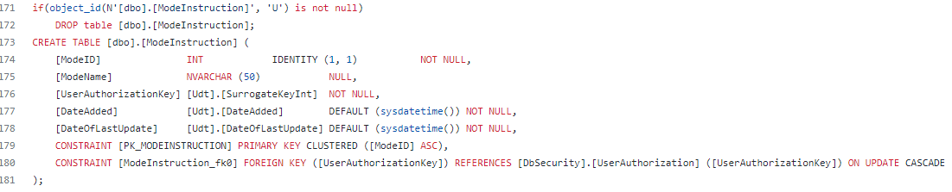
Mode Instruction Code

Slide 51

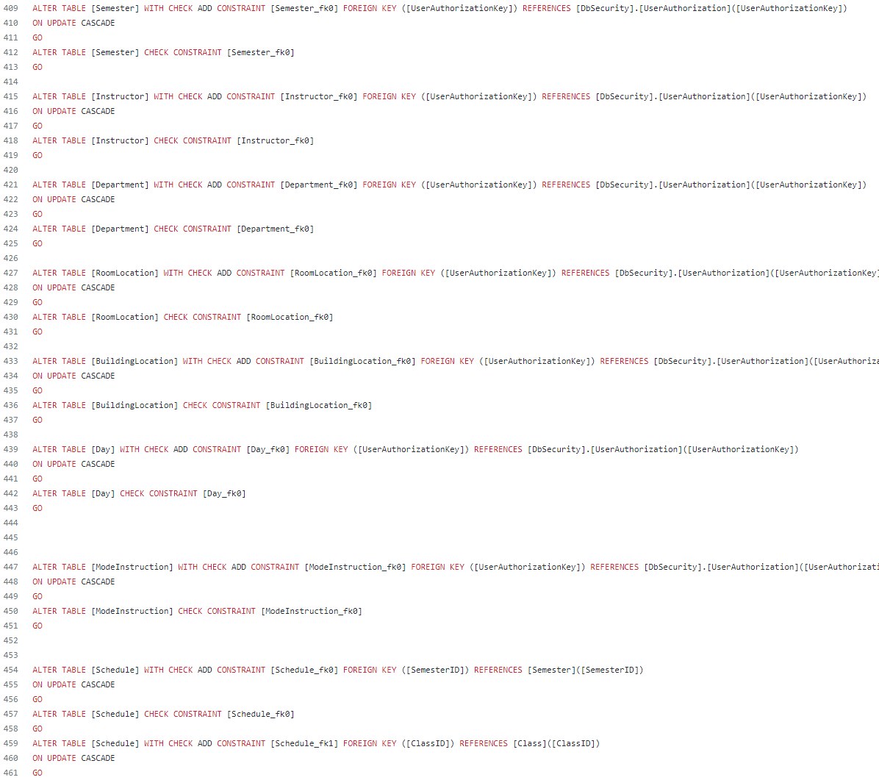
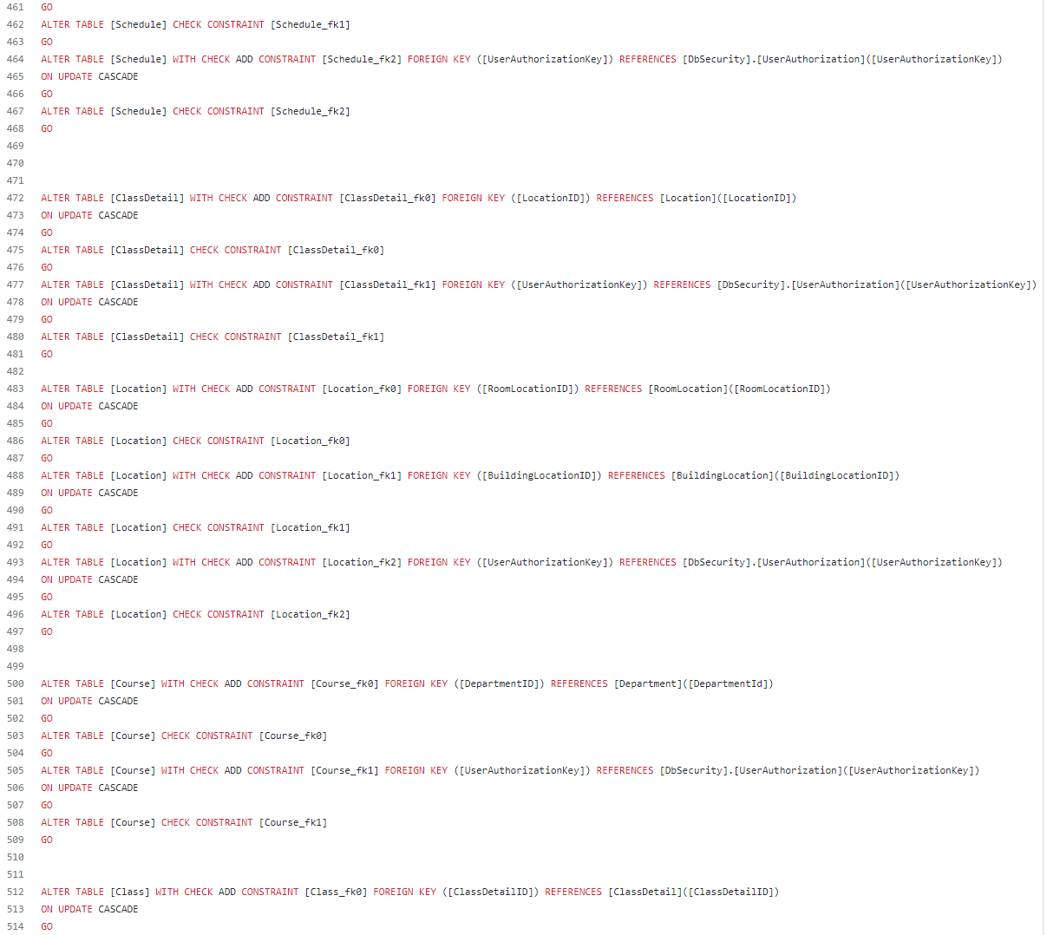
Creation of Foreign Keys

Slide 52

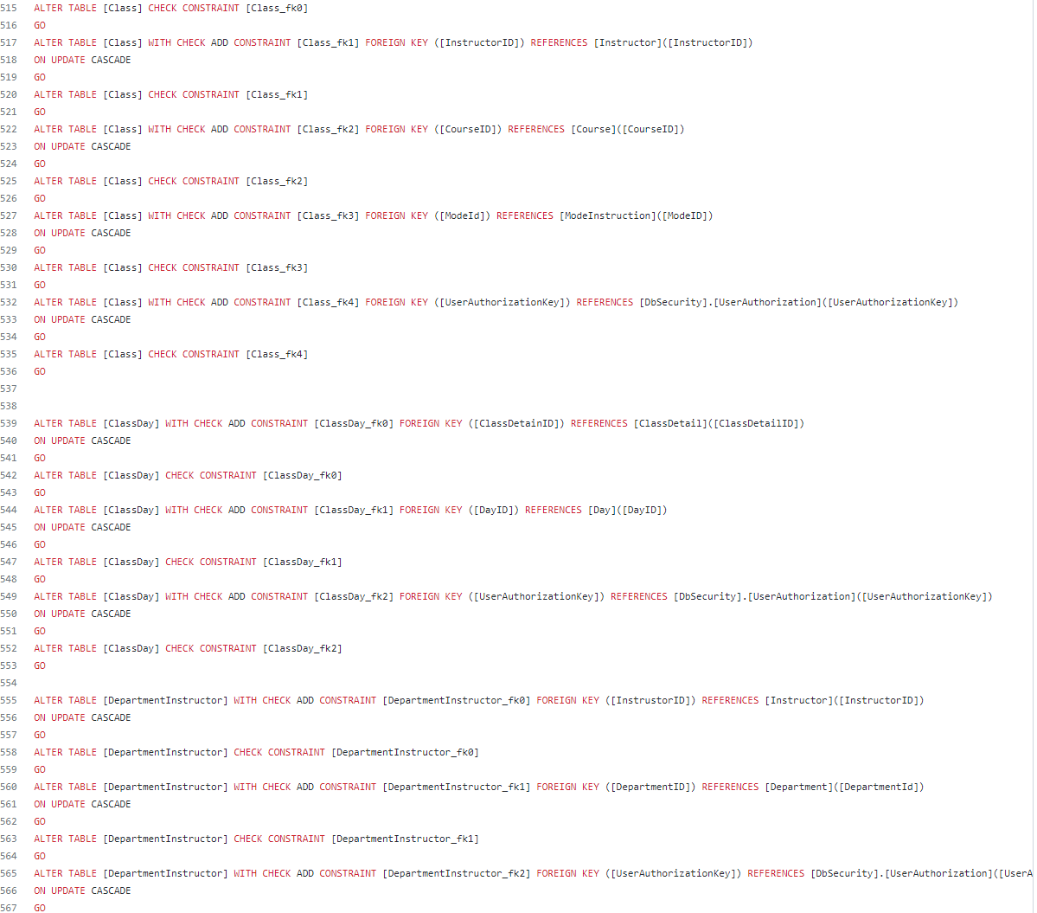
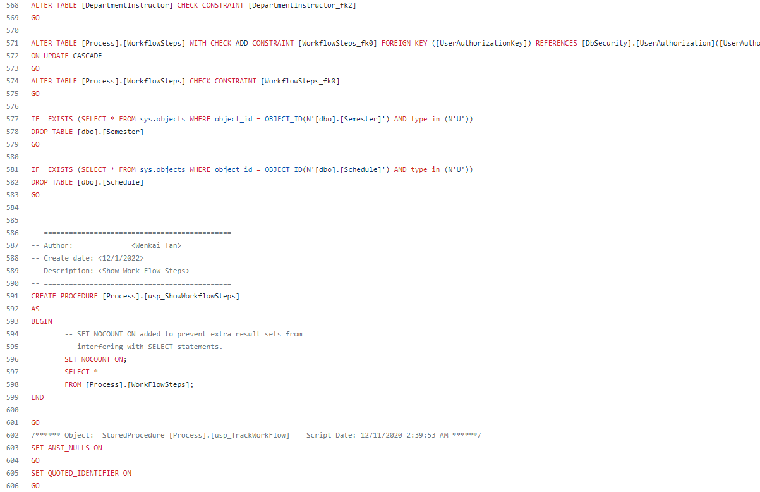
Creation of Foreign Keys (cont.)

Slide 53
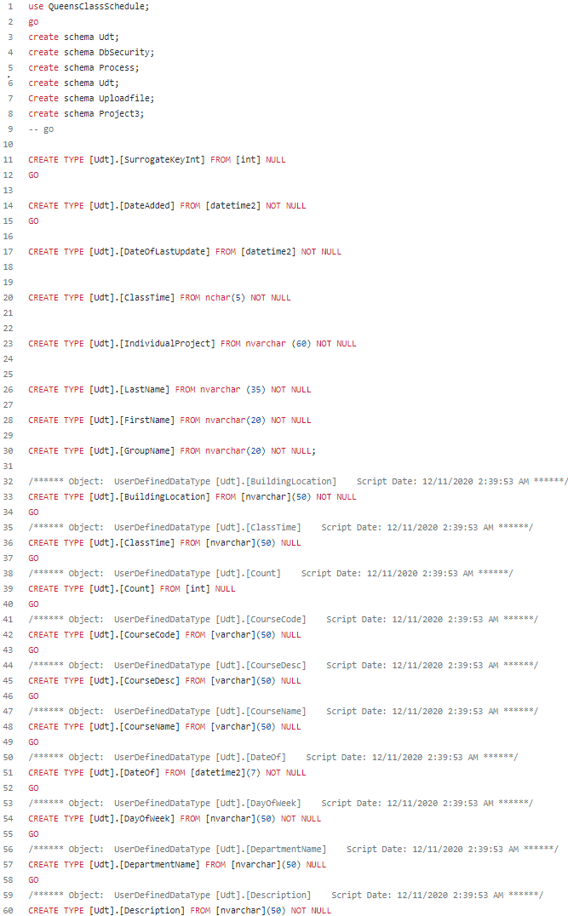
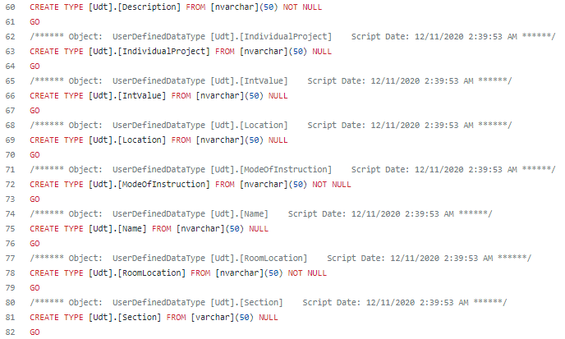
Create Data Types

Slide 54
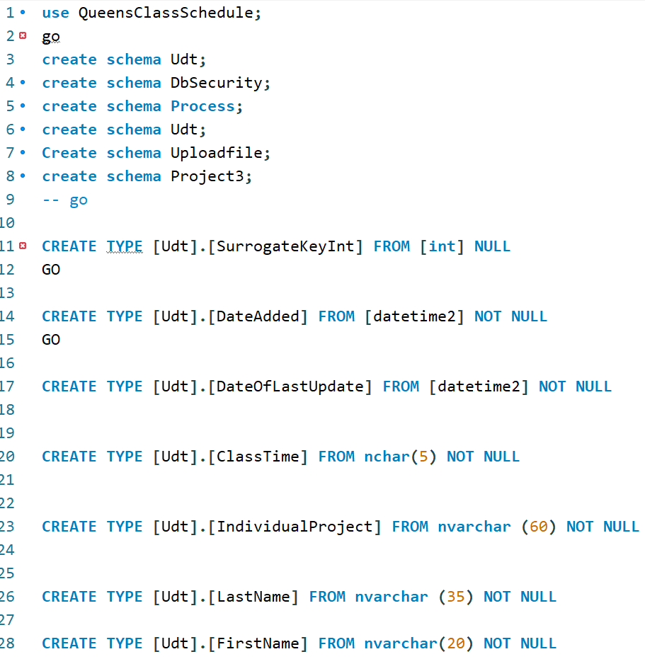

UDT Code

Slide 55


User Authorization Code

Slide 56



Queries

Slide 57


Queries (cont.)

Slide 58



Queries (cont.)

Slide 59


Queries (cont.)

Slide 60


Queries

Slide 61


Database Modelling Video

Slide 62


JDBC Modelling video

Slide 63

Reflection
Redgate really helped us be productive.
Using SQL Prompt to share formatting settings across our team to consistently format code before checking it into source control really helped us save a lot of time on formatting each others code.
Prevent the build-up of technical debt in your database code – spot immediately issues that could eventually cause problems with performance, behavior, or security.
Minimize delays in deployment – these are inevitable if code issues are detected only at deployment

